Slide 1
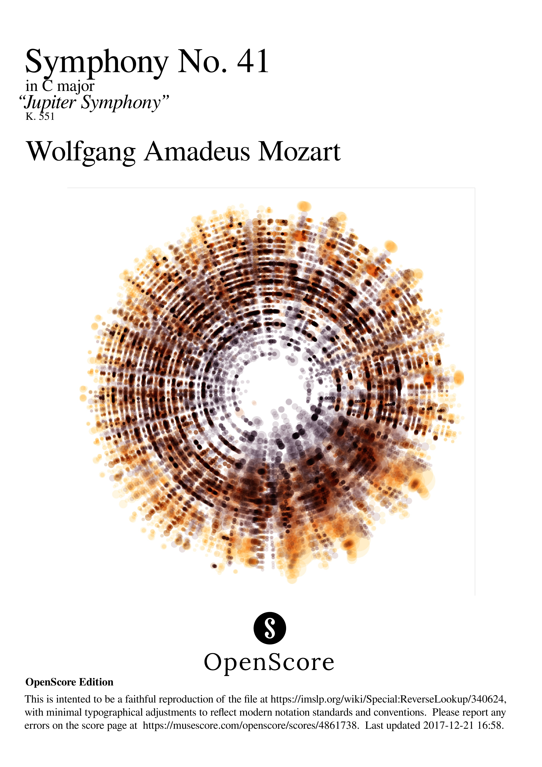

Slide 2
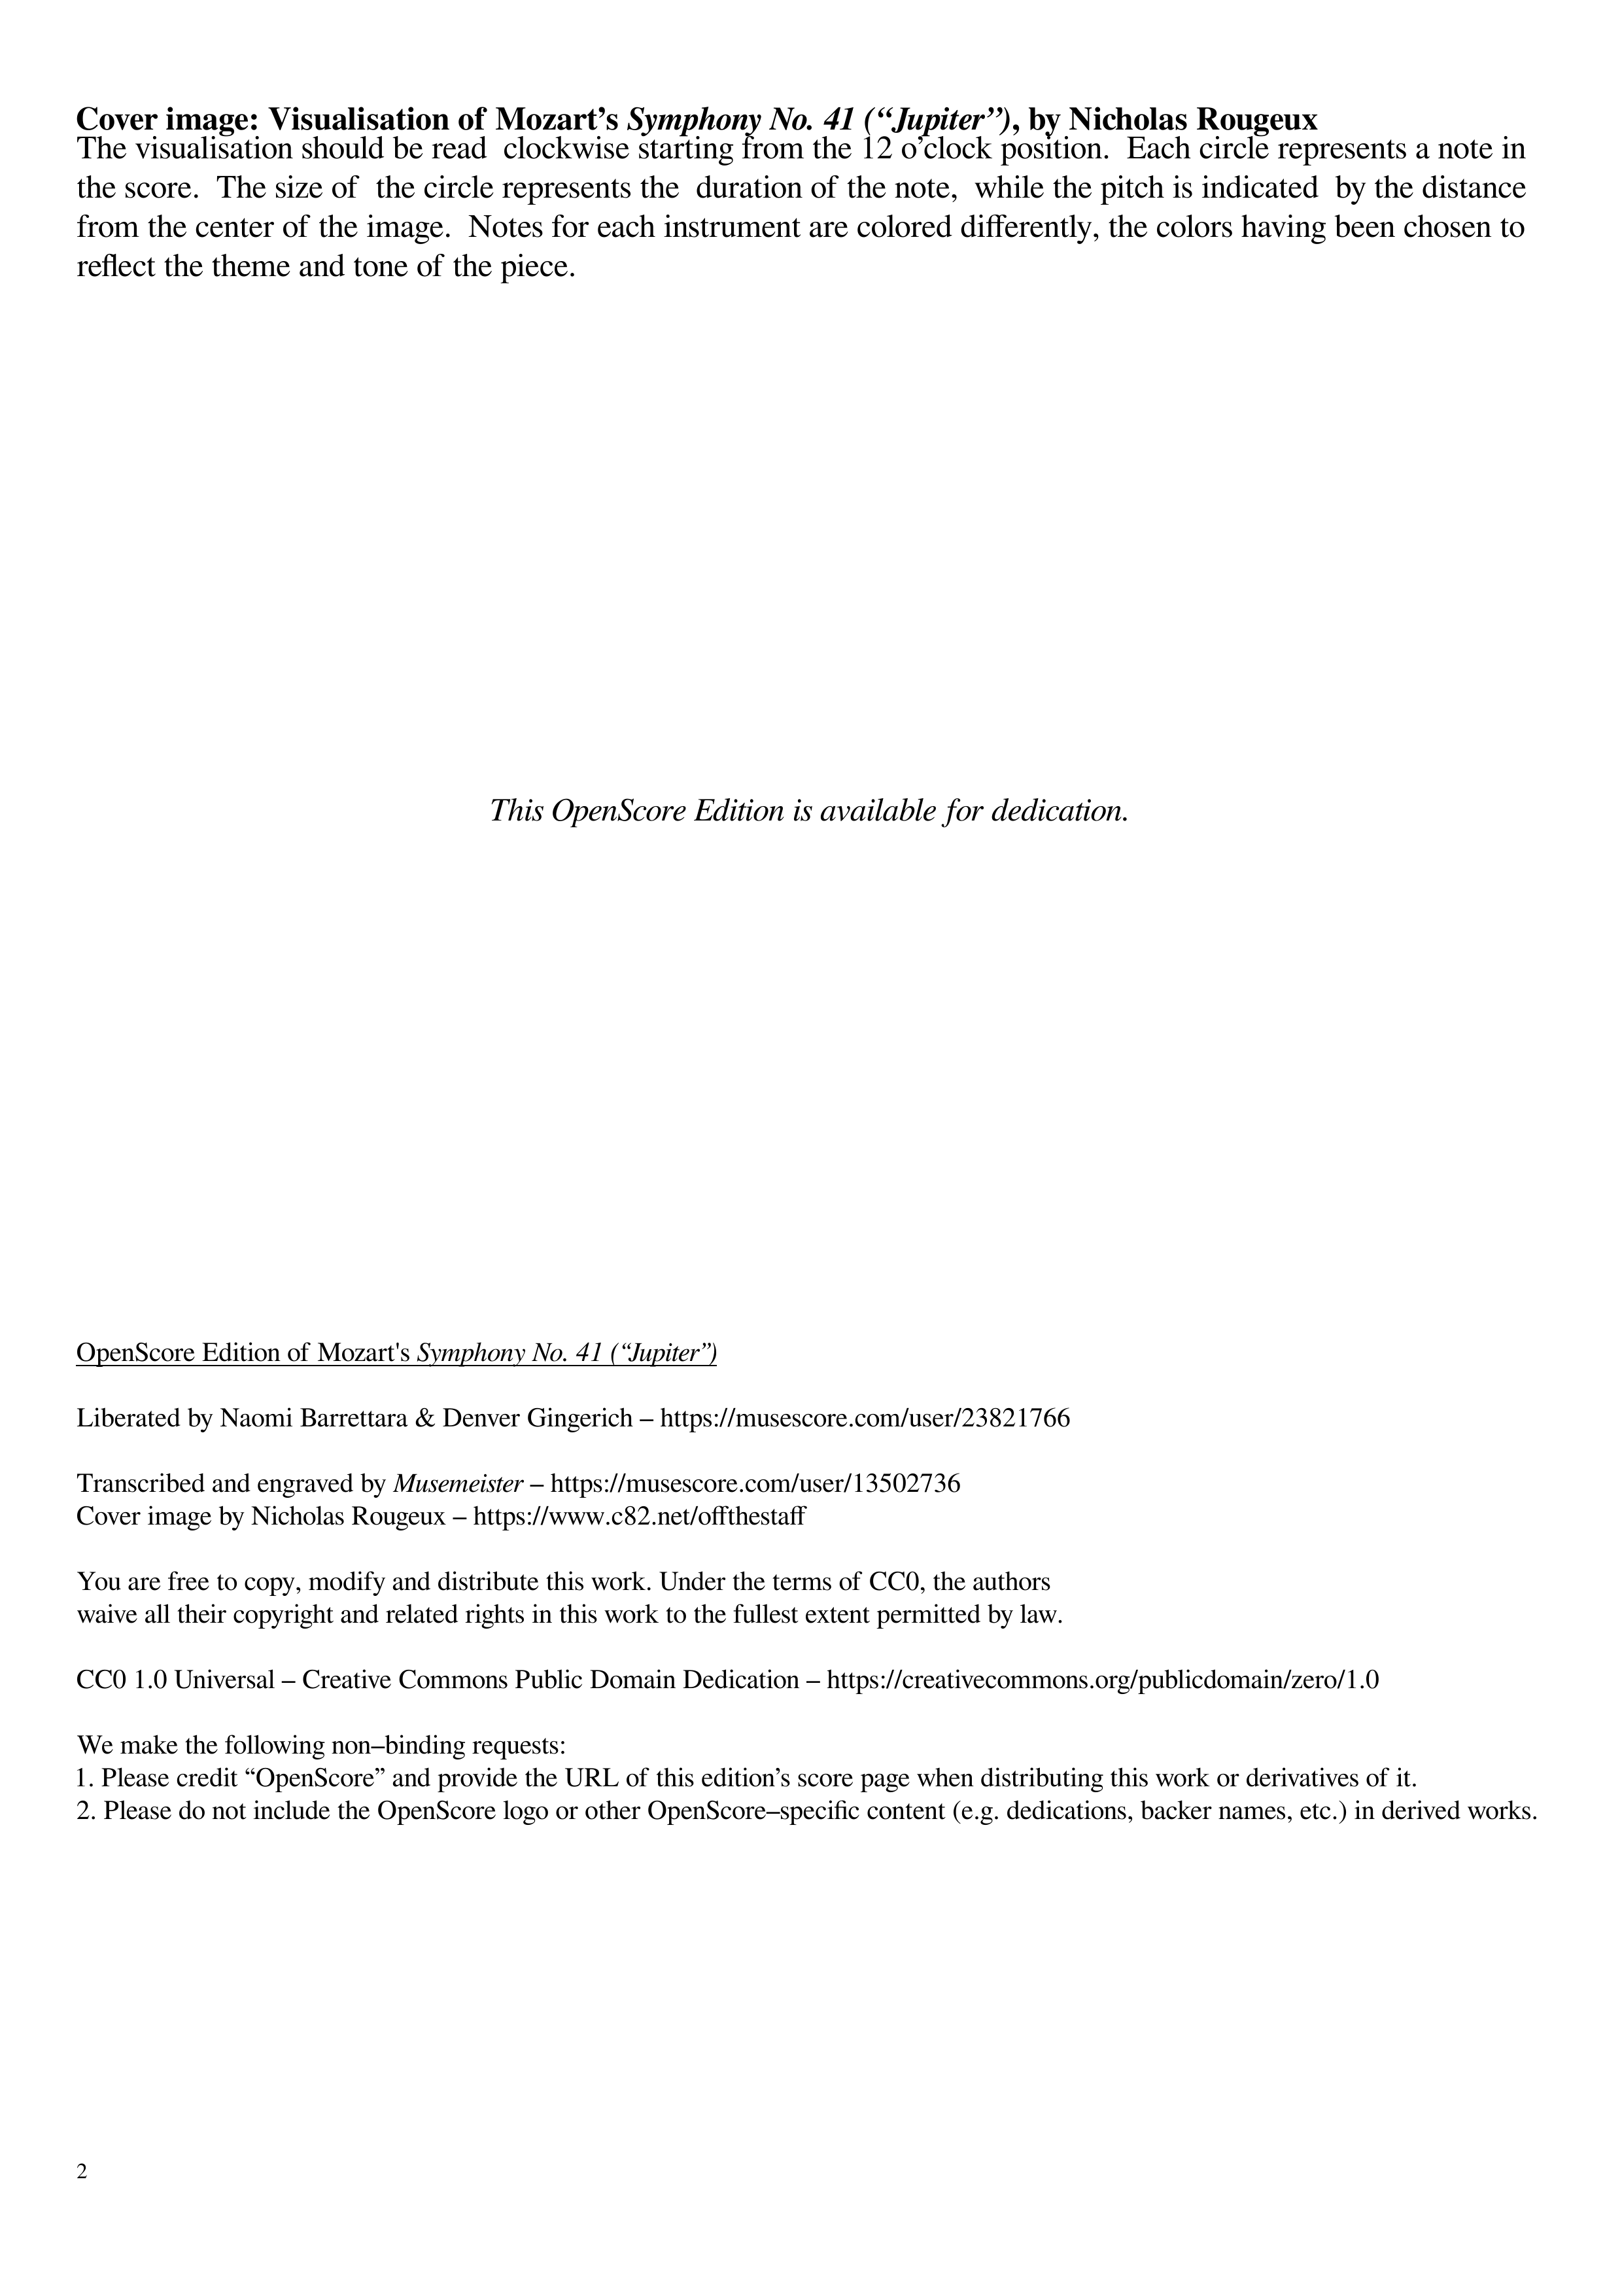

Slide 3
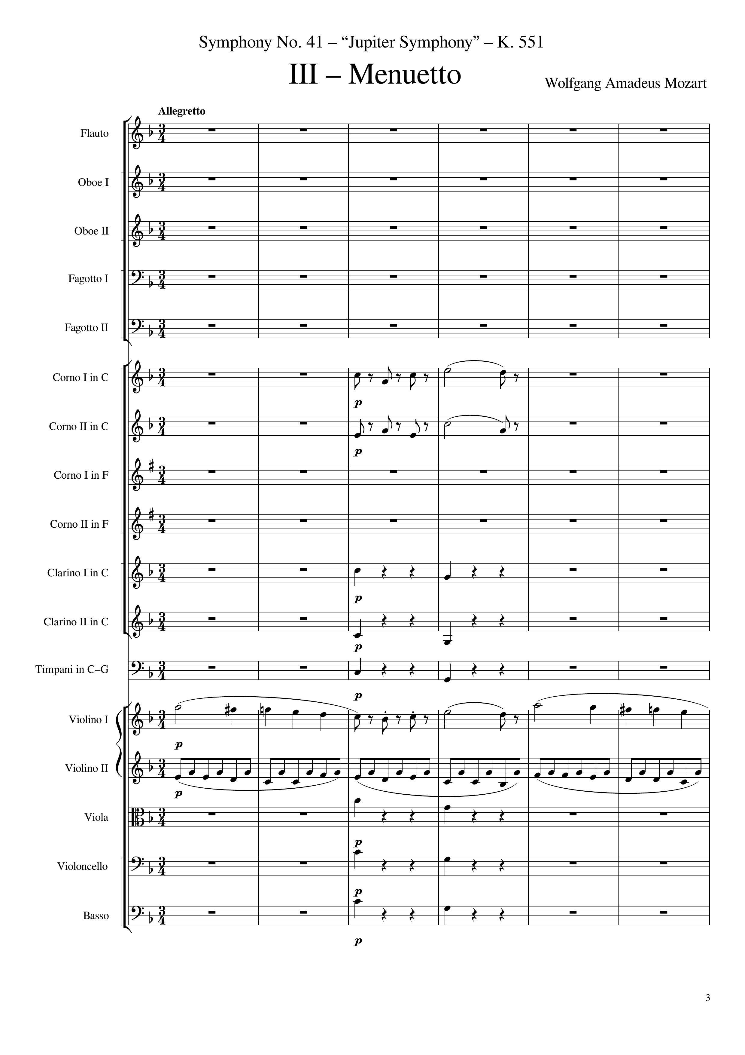
mel
mel+harm
rhythm+harm
rhythm+harm
rhythm+harm
mel
rhythm
rhythm+harm
rhythm+harm
rhythm+harm
0
18
Notes:
26:55

Slide 4
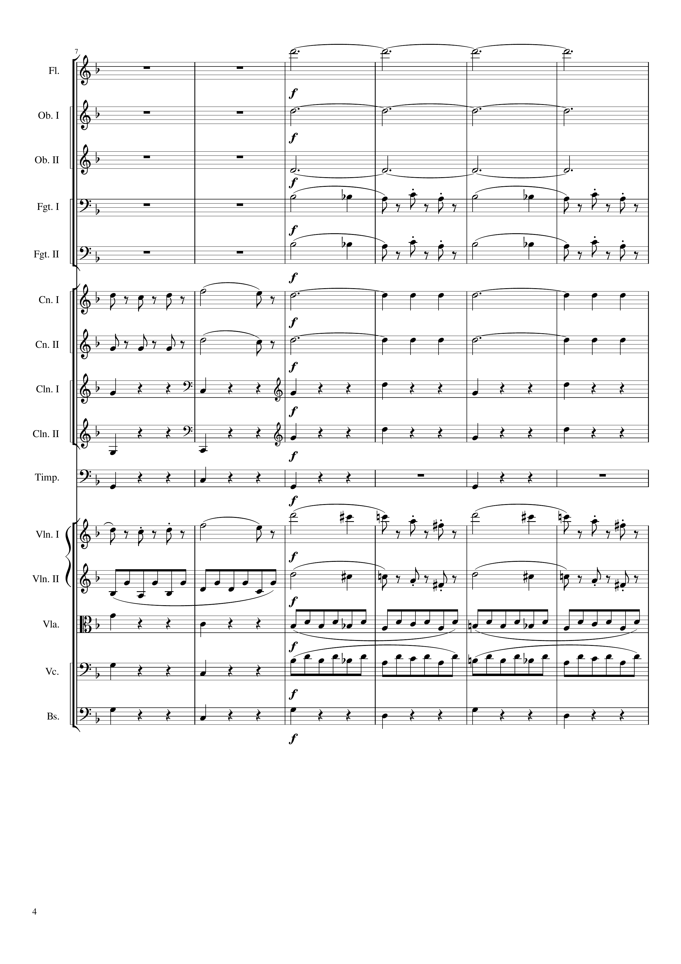
harm
harm
harm
mel+harm
mel+harm
mel
rhythm
mel+harm
rhythm
rhythm+harm
rhythm+harm
rhythm+harm
rhythm+harm
rhythm+harm
rhythm+harm
mel
mel
rhythm
mel
rhythm+harm
rhythm
rhythm+harm
rhythm
rhythm+harm
rhythm+harm
18
24
36

Slide 5
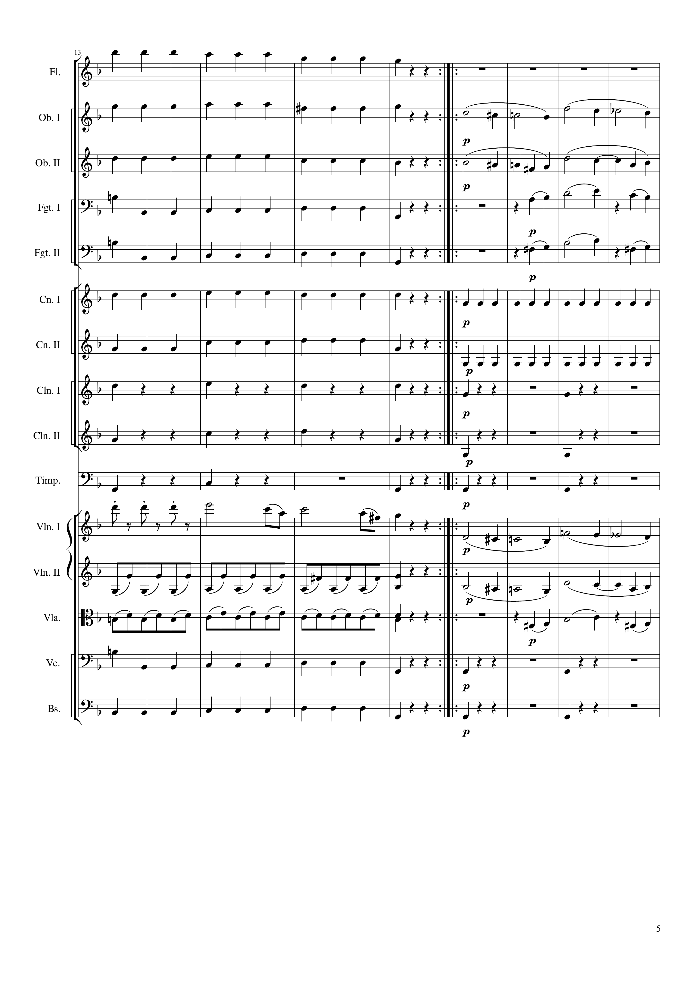
rhythm+harm
rhythm+harm
mel
rhythm+harm
mel
rhythm+harm
mel
rhythm+harm
mel
rhythm+harm
rhythm
rhythm+harm
rhythm
rhythm+harm
rhythm
rhythm+harm
rhythm
rhythm+harm
rhythm
mel
mel
rhythm
mel
rhythm
mel
rhythm+harm
rhythm
rhythm+harm
rhythm
36
48
108
96
Notes:
27:35

Slide 6
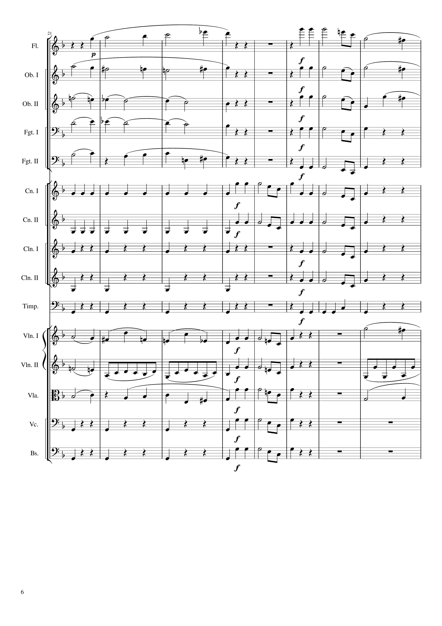
mel
mel
mel
mel
mel
harm
mel
mel
harm
mel
mel
mel
rhythm
mel
mel
rhythm
mel
mel
rhythm
mel
rhythm
mel
rhythm
rhythm
mel
mel
mel
mel
rhythm
mel
mel+rhythm
mel
mel
mel
rhythm
mel
rhythm
mel
108
117
132

Slide 7
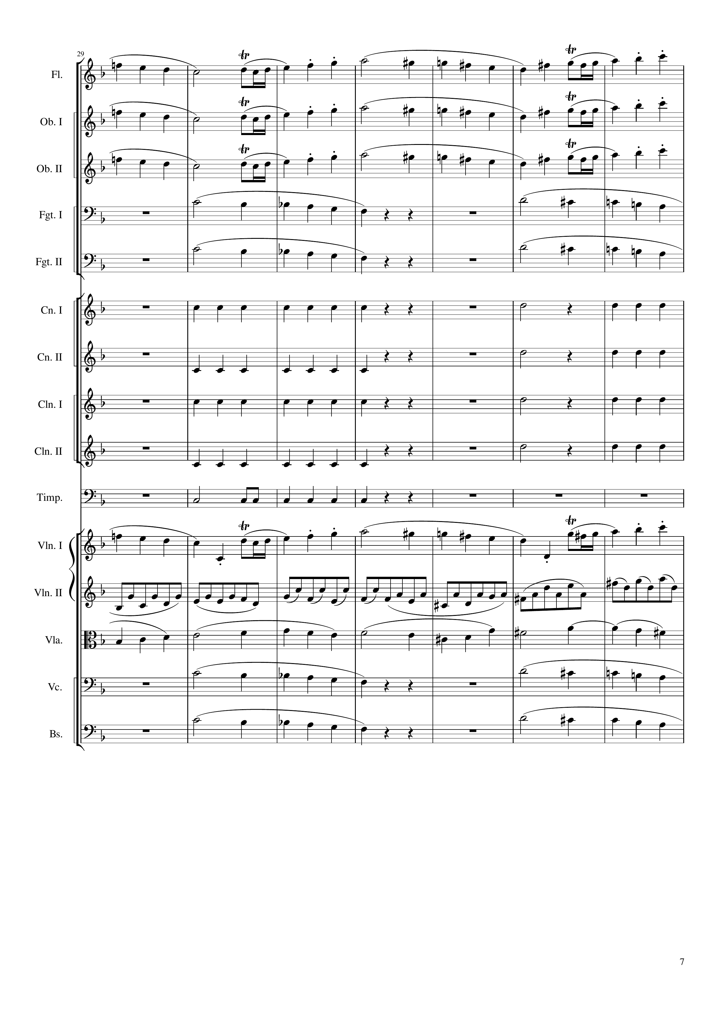
mel
mel
mel
mel
mel
mel
mel
rhythm
rhythm
rhythm
rhythm
rhythm
rhythm
rhythm
rhythm
rhythm
mel
mel+rhythm
mel
mel
mel
mel
mel
132
153

Slide 8
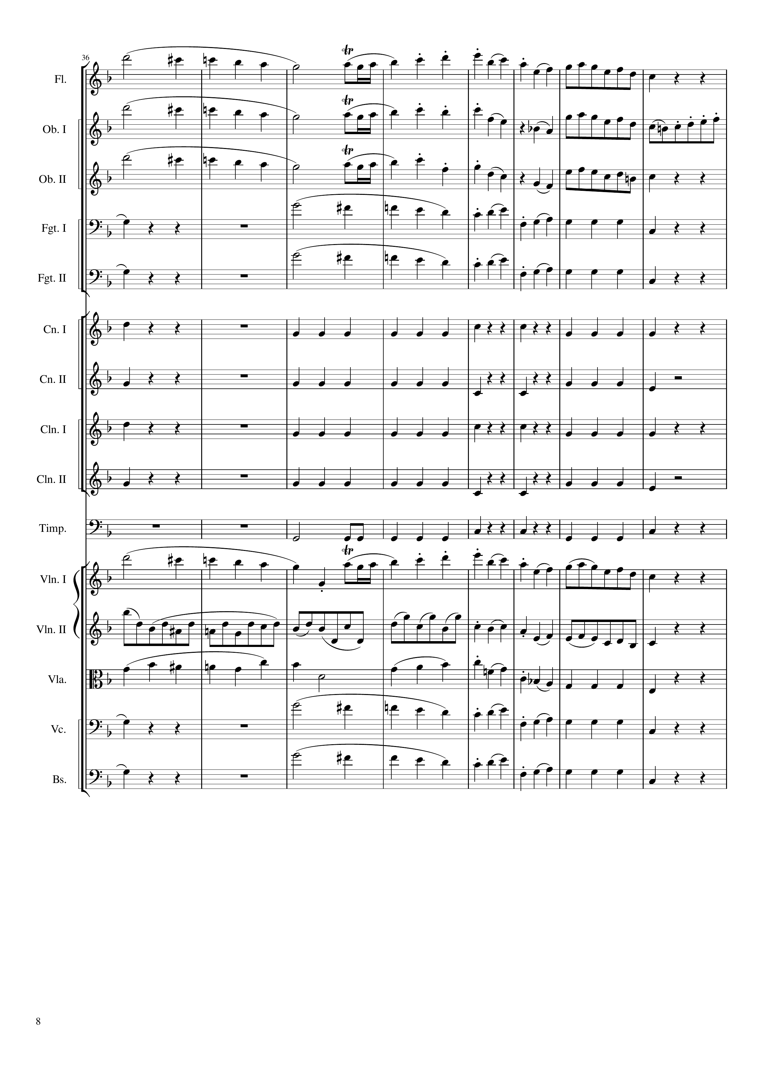
mel
mel
mel
mel
mel
mel+harm
mel
mel
mel+harm
rhythm
rhythm
rhythm
rhythm
rhythm
rhythm
rhythm
rhythm
rhythm
mel
mel+rhythm
mel
mel
mel+harm
mel
mel
mel+harm
mel
mel
mel+harm
153
165
177

Slide 9
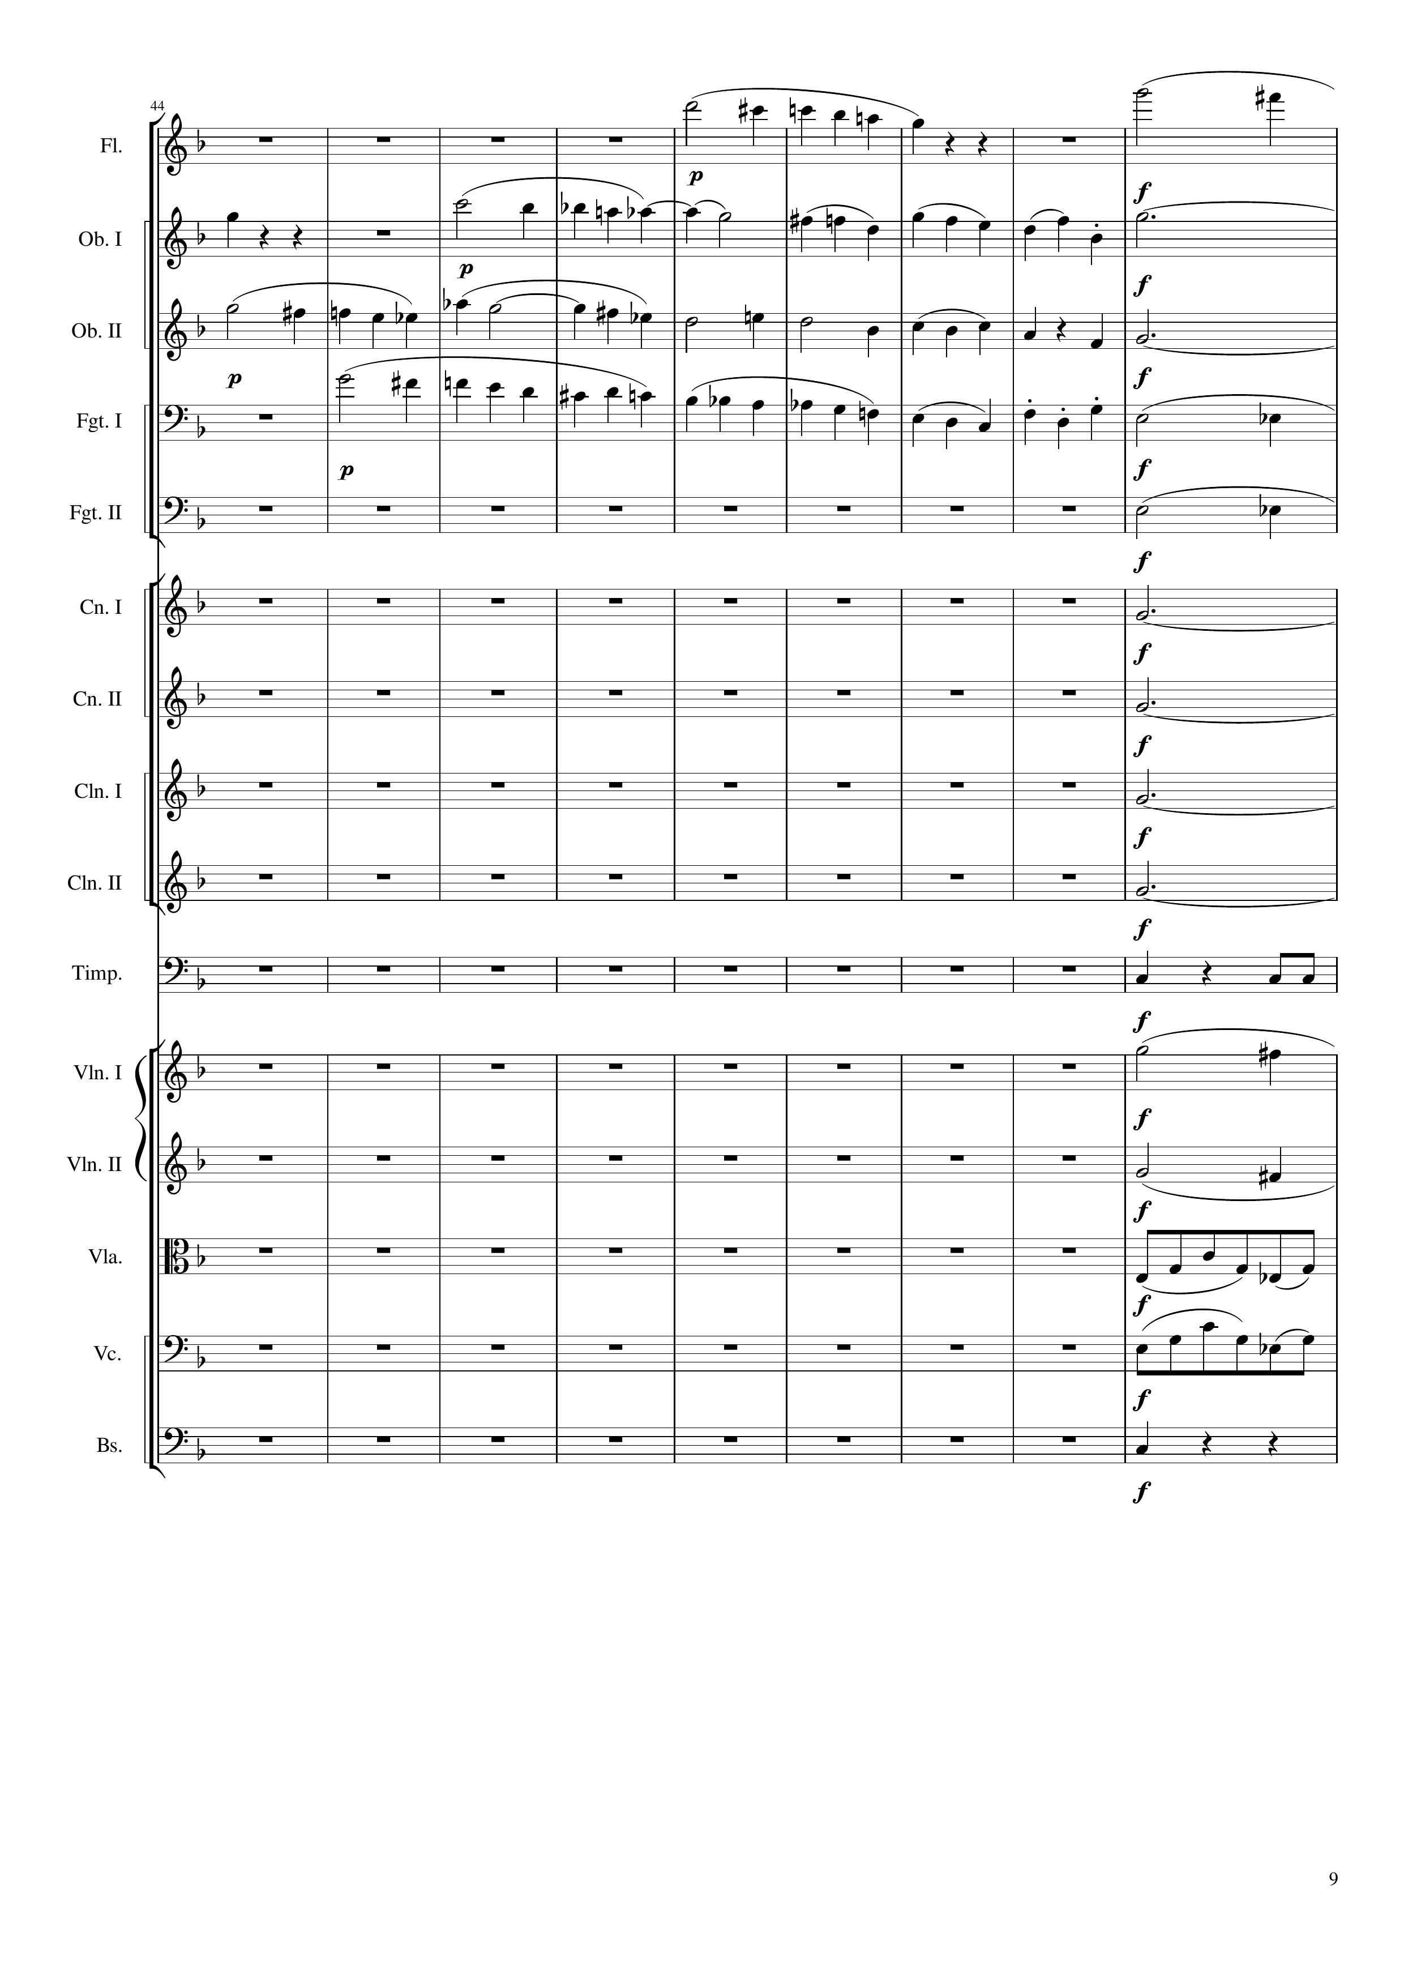
mel
mel
mel
mel
harm
mel
harm
mel
mel+harm
mel+harm
rhythm
rhythm
rhythm
rhythm
rhythm
mel
mel
rhythm
rhythm
rhythm
177
204

Slide 10
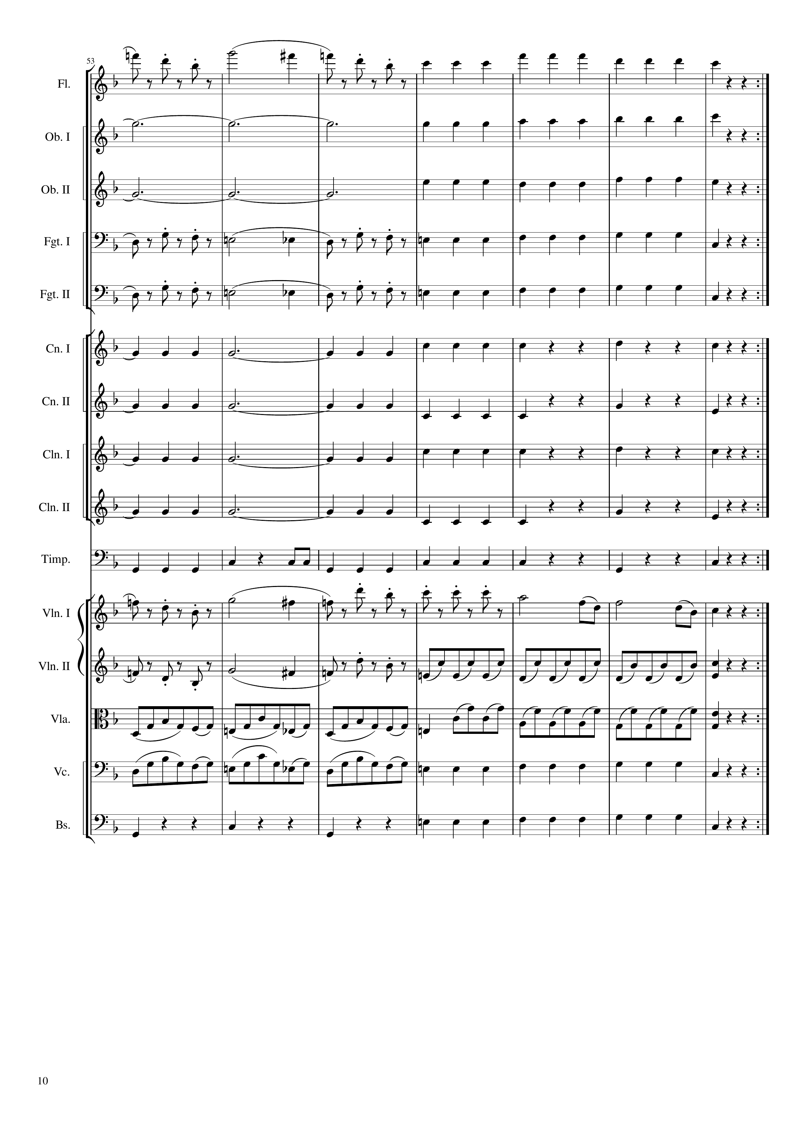
mel
rhythm+harm
harm
rhythm+harm
harm
rhythm+harm
mel+harm
rhythm+harm
mel+harm
rhythm+harm
rhythm
rhythm+harm
rhythm
rhythm+harm
rhythm
rhythm+harm
rhythm
rhythm+harm
rhythm
rhythm+harm
mel
mel
mel
rhythm
rhythm
rhythm
rhythm
rhythm+harm
rhythm
rhythm+harm
204
213
225
354
Notes:
28:25

Slide 11
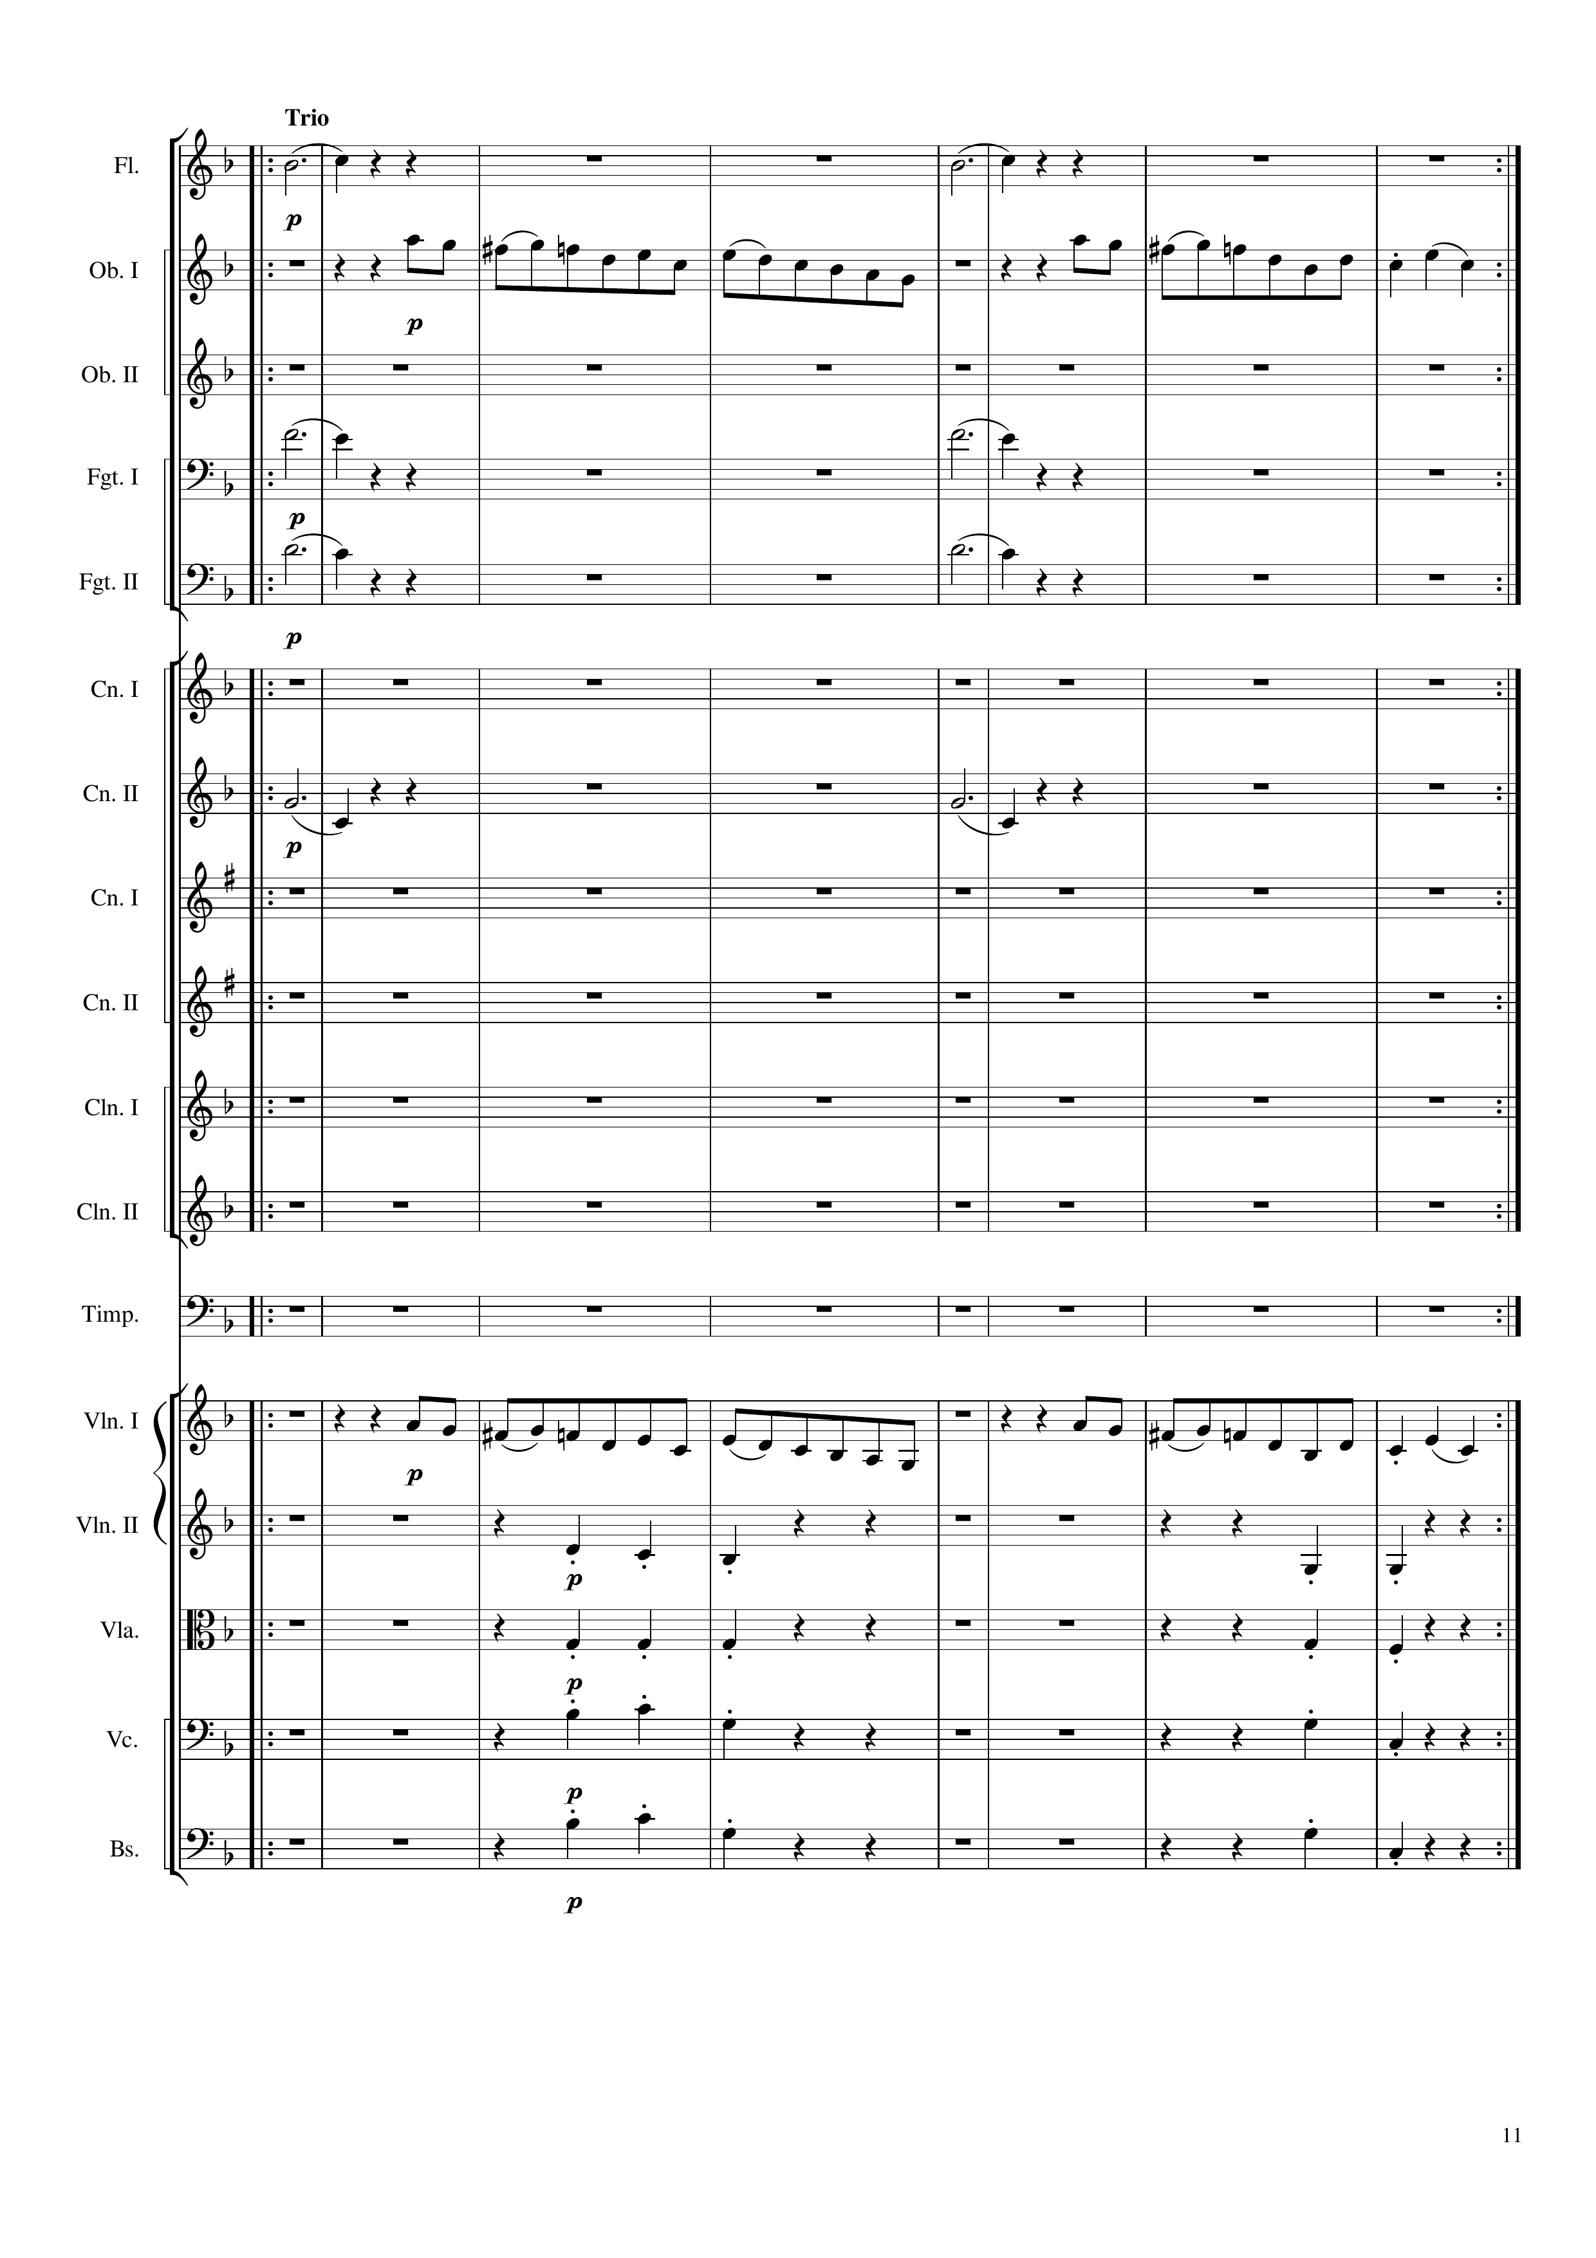
harm
harm
mel
mel
harm
harm
harm
harm
harm
harm
mel
mel
rhythm+harm
rhythm+harm
rhythm+harm
rhythm+harm
rhythm+harm
rhythm+harm
rhythm+harm
rhythm+harm
354
366
378
402
Notes:
29:25

Slide 12
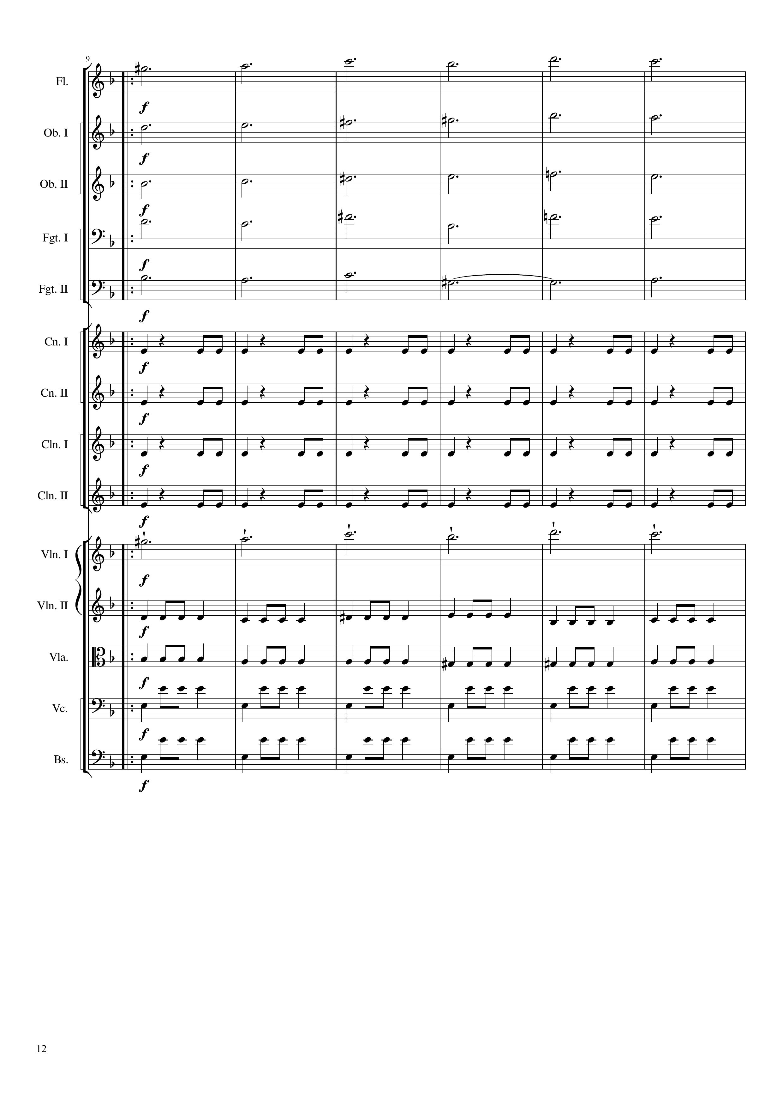
mel
harm
harm
harm
harm
rhythm
rhythm
rhythm
rhythm
mel
rhythm
rhythm
rhythm
rhythm
402
420

Slide 13
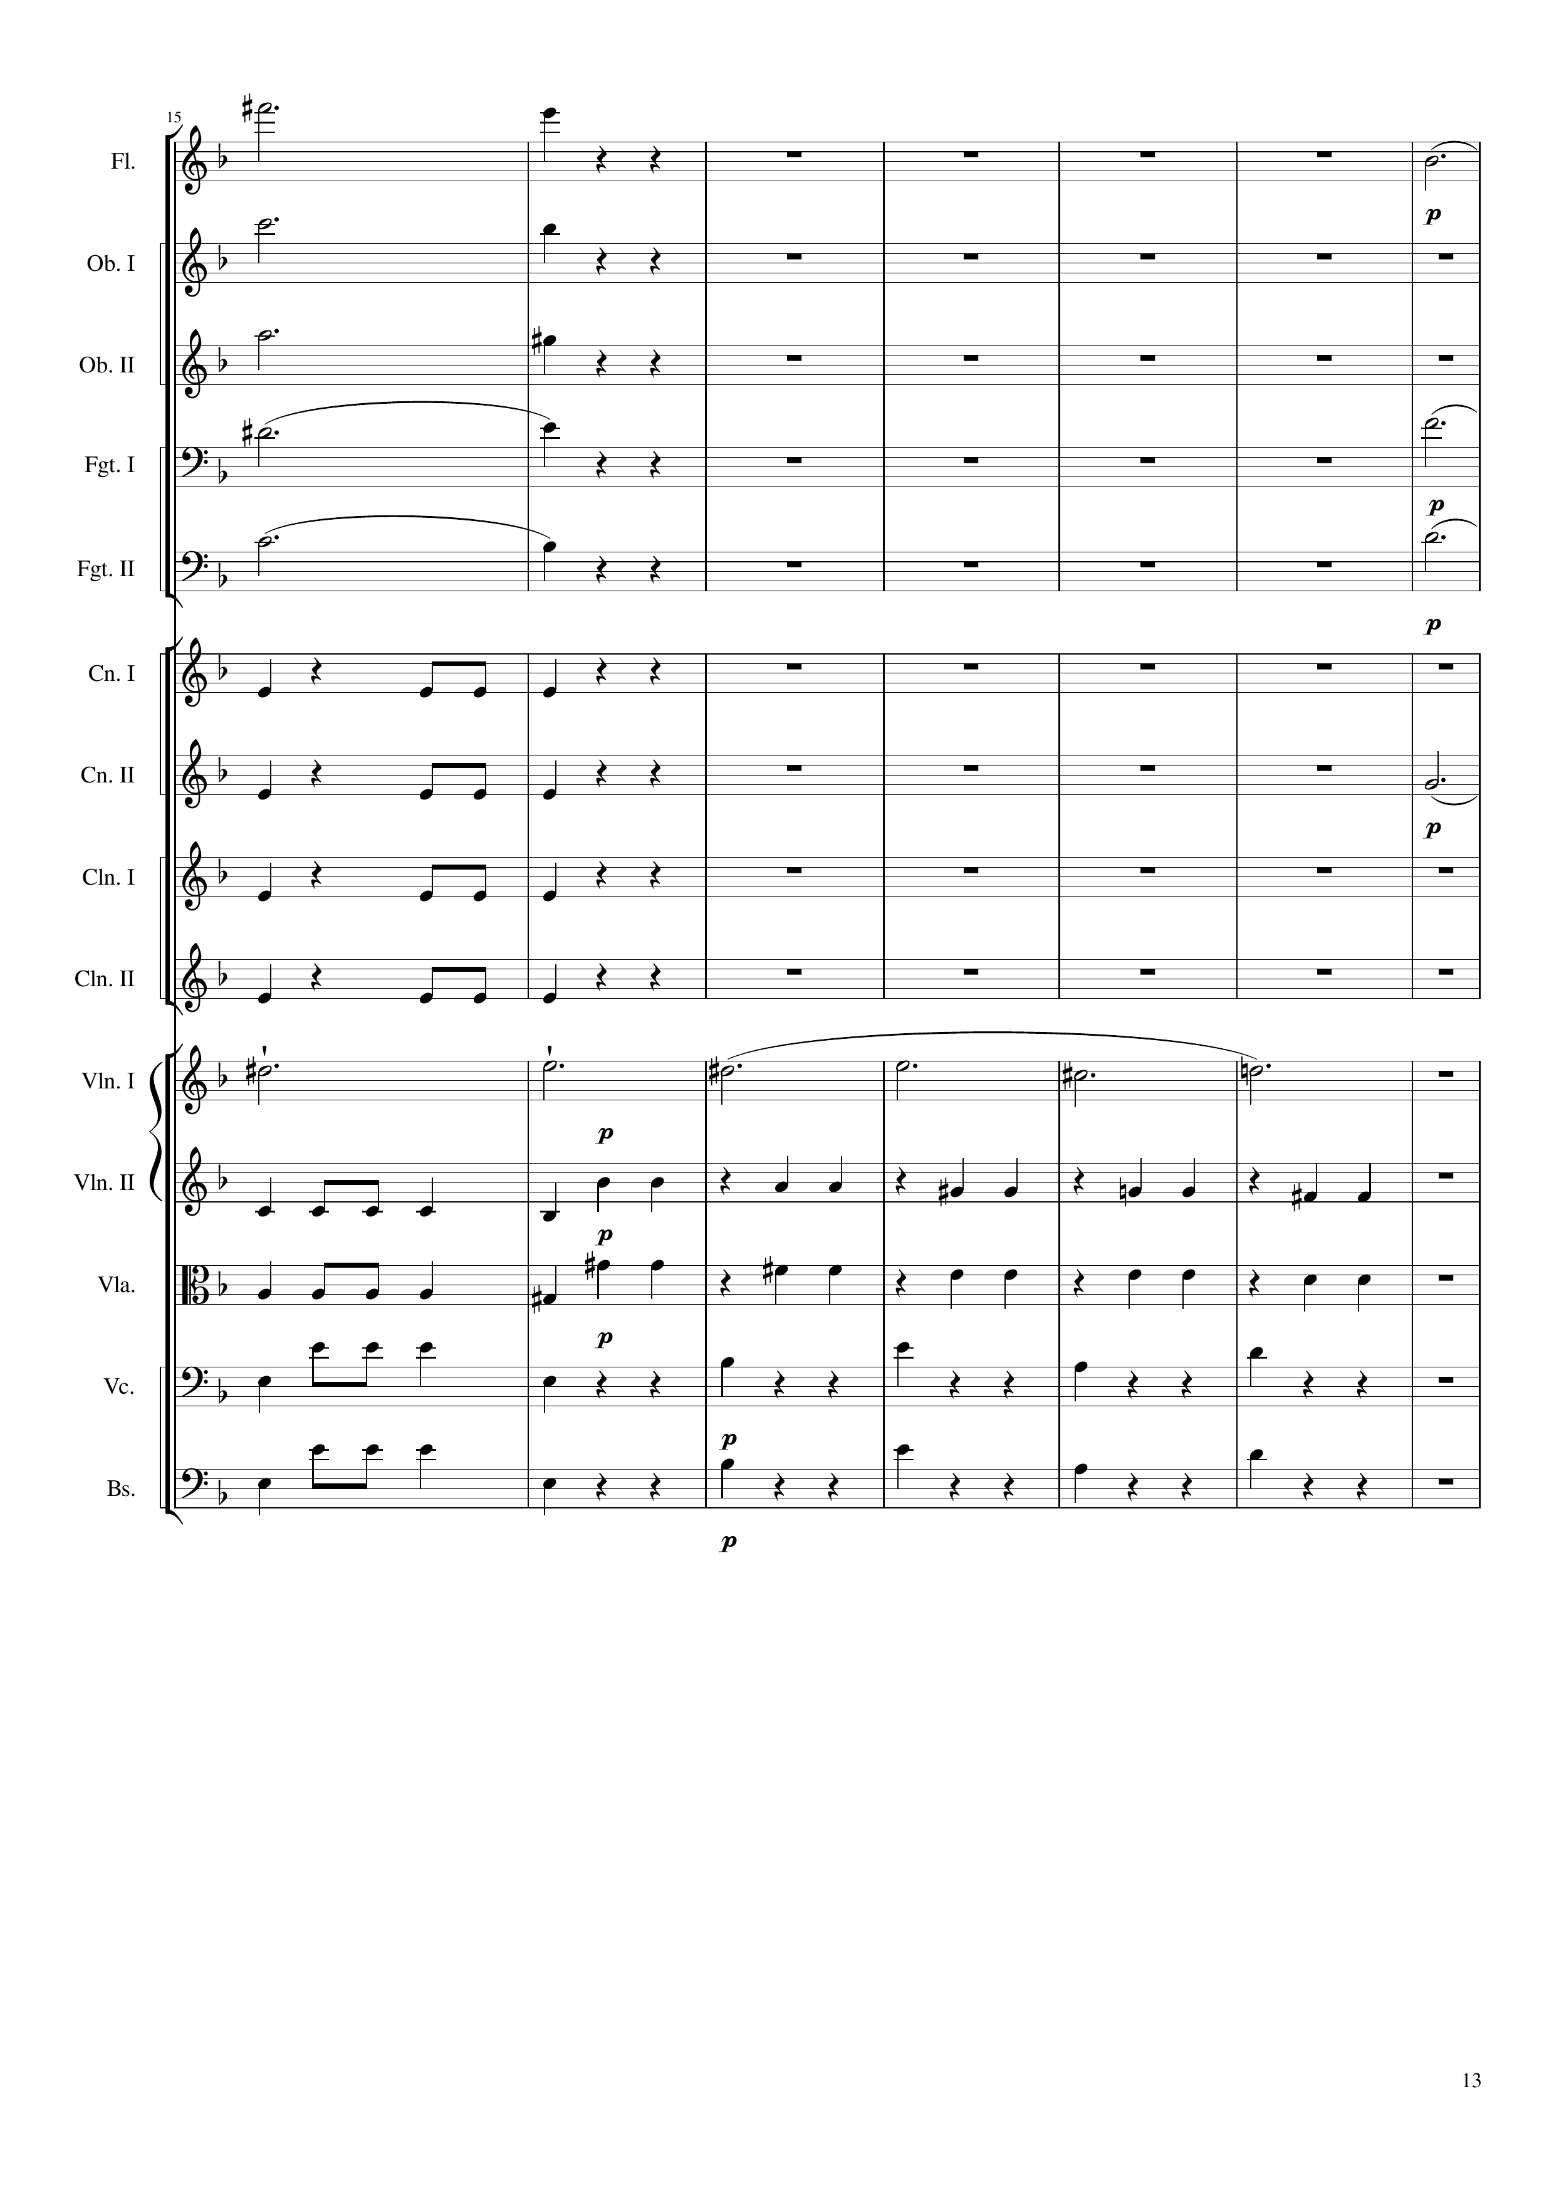
mel
harm
harm
harm
harm
harm
harm
harm
rhythm
rhythm
harm
rhythm
rhythm
mel
rhythm
rhythm
rhythm
rhythm
420
441

Slide 14
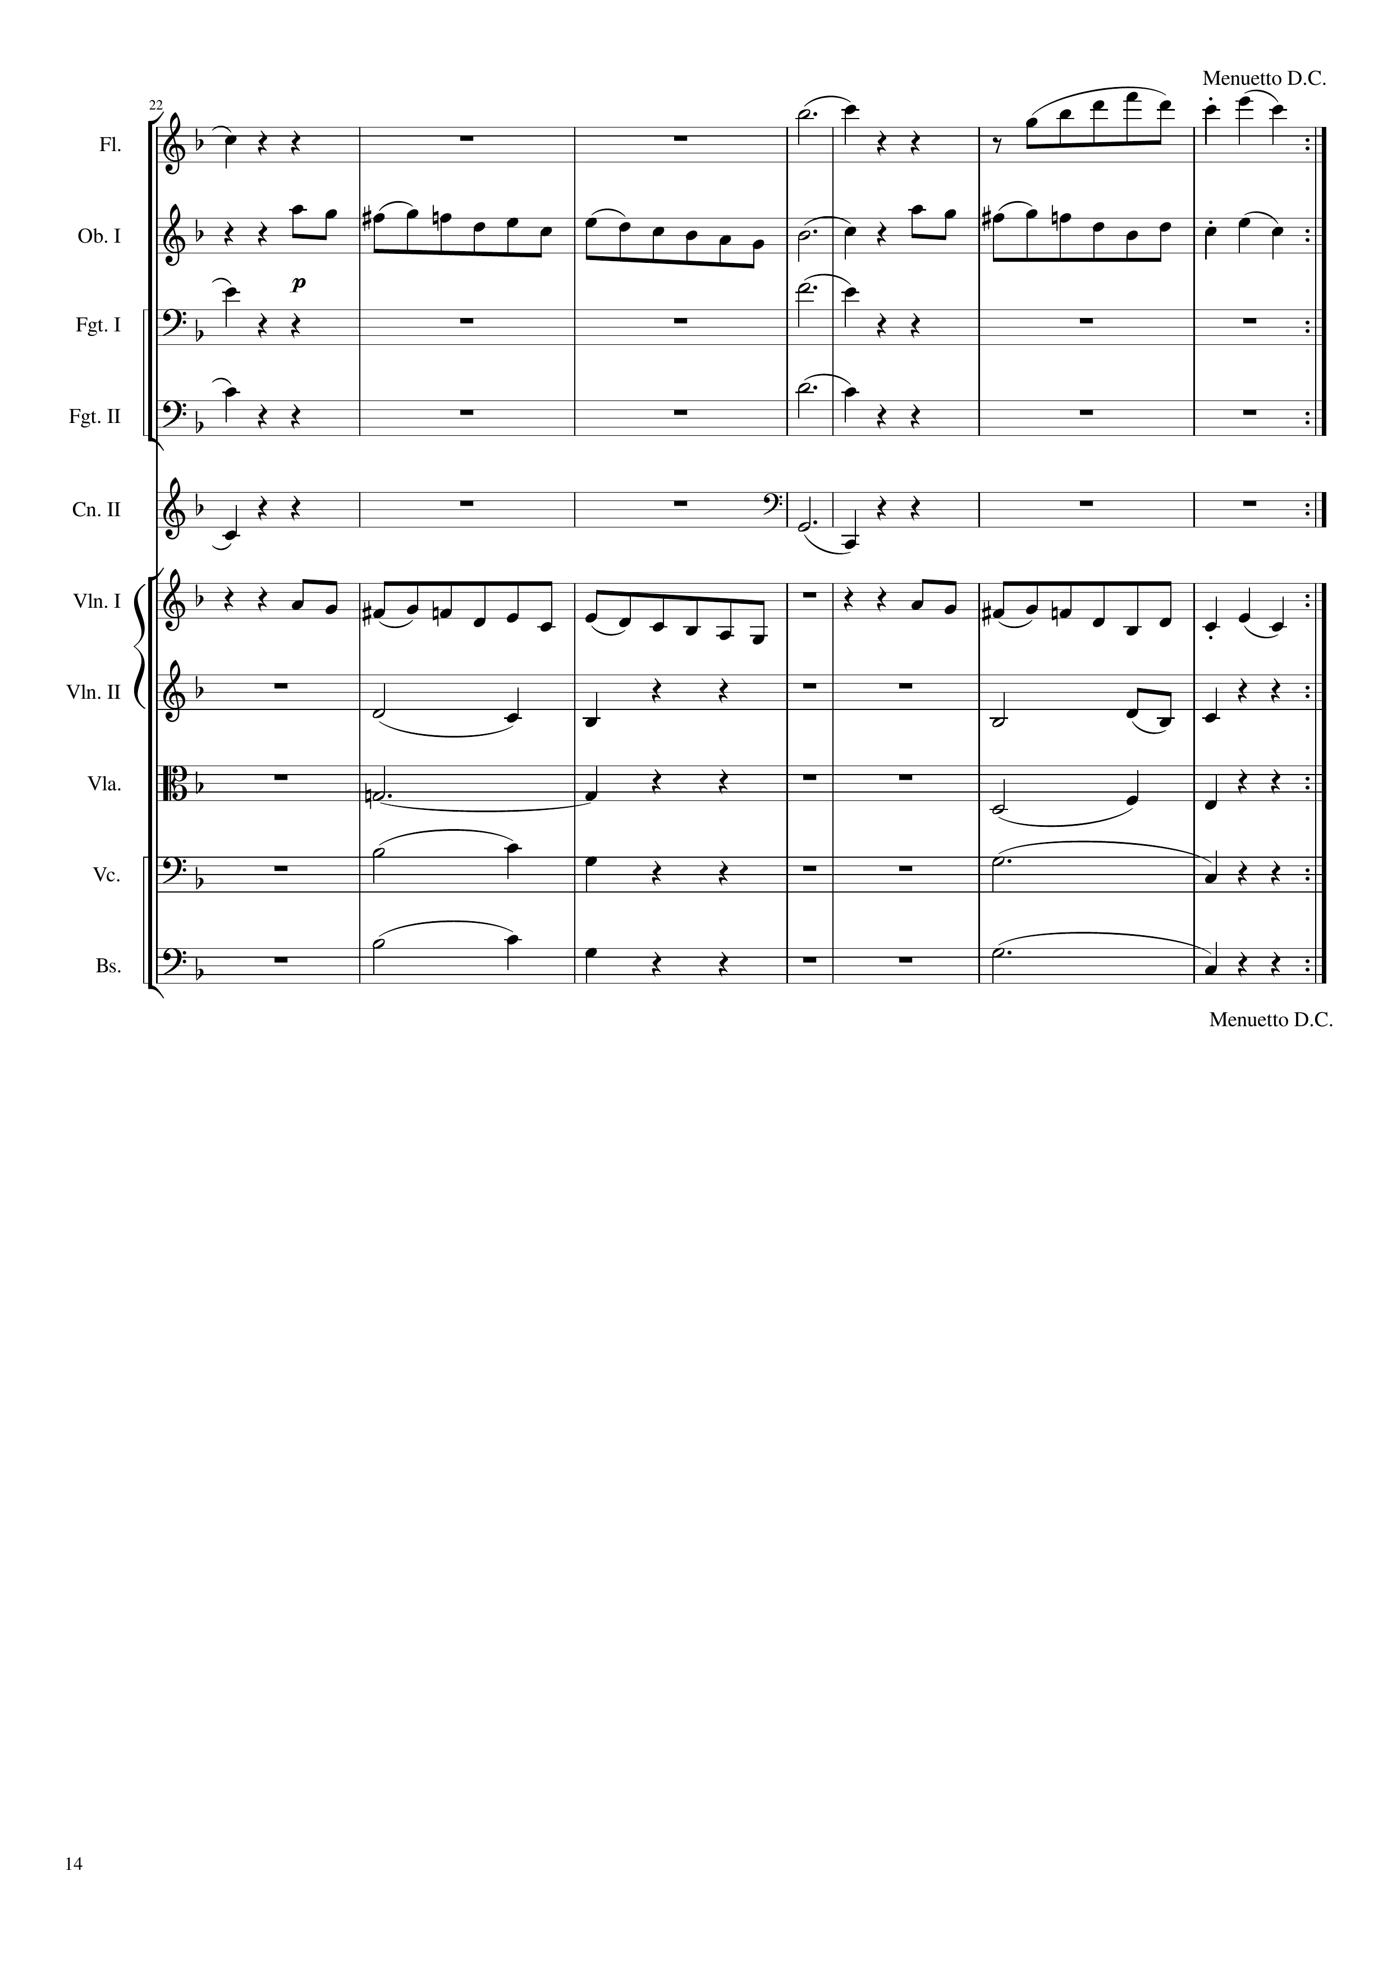
harm
harm
mel
mel
harm
mel
harm
harm
harm
harm
harm
harm
mel
mel
harm
harm
harm
harm
harm
harm
harm
harm
441
462
522

Slide 15


